Slide 1
Securing a Site Collection

Slide 2
Agenda
SharePoint Security Architecture
Default SharePoint Groups and Permission Levels
Designing and Implementing Custom Security
Restricting SharePoint Designer 2010 Use

Slide 3
SharePoint Security Architecture
Site Collection
Permission Assignments
Permission Levels
Sites
Permission Assignments
Permission Levels
Pages and Lists
Permission Assignments
Permission Levels
HIERARCHY
INHERITANCE
Permission Assignments are inherited separately from Permission Levels
Notes:
SharePoint’s Security Architecture is based on the hierarchical layout of site collections and the concept of inheritance. Permissions assigned at the top level site of the site collection are inherited by all 2nd tier child sites of that top level site (by default). In turn, the permissions in place at a 2nd tier child site (whether inherited or explicitly assigned after disabling inheritance) are inherited by all of the pages, lists and libraries in that site (by default) as well as by all 3rd child sites beneath that site in the site collection (by default). The permissions in place on a list or library are inherited by all folders and items within that list or library by default as well.
But there are actually 2 separate inheritance streams in play. SharePoint manages permission assignments and their inheritance stream separately from managing permission level objects and their inheritance stream. In other words, it is possible for a 2nd tier child site to still be inheriting is permission level objects (and their configuration including the permission compilation) from its parent site while having disabled permission assignment inheritance so that administrators at the child site can dictate which users receive which permission levels autonomously from the parent site.

Slide 4
SharePoint Security Objects
PRINCIPALS
PERMISSIONS
SECURABLES
Permission Levels
Precompiled sets of individual permissions
Granted just like a permission
Individual Permissions
List Permissions
Site Permissions
Personalization Permissions
Sites
Pages
Lists
Libraries
Folders
Items
SharePoint Person Object
Mapped to a directory service user or group account
SharePoint Group Object
SharePoint Person Object as member
Directory service group account as member
Notes:
Using SharePoint security objects, site administrators and site collection administrators can grant very granular permissions to specific individuals in an effort to accommodate highly confidential or sensitive data and regulations compliance.
SharePoint uses three classifications of objects to enforce security:
Principals: “Who”– objects that represent security entities that will be authenticated onto the resource and granted permissions to access the resource at a particular level of authority.
Permissions: “How Much”– objects that represent a level of authority which can be handed out to users for gaining access to resources
Securables: “What”– resource objects that will be accessed by users at a specific level of authority

Slide 5
Principals
PRINCIPALS
SharePoint Person Object
Mapped to a directory service user or group account
SharePoint Group Object
SharePoint Person Object as member
Directory service group account as member
Notes:
Principals
SharePoint security principals include just SharePoint person objects and SharePoint group objects. However, person objects must map back to a valid security object in the authentication provider’s directory. For example, on a stand-alone SharePoint server in a peer-to-peer workgroup a SharePoint person object must map back to a local Windows user account or a local Windows group account from the resident OS. On a SharePoint server in a Microsoft Active Directory domain, a SharePoint person object must map back to either a domain user/group object from Active Directory or a local Windows user/group account from the resident OS.
SharePoint group objects, on the other hand, do not map back to anything from the authentication provider. They are independent SharePoint objects designed to reduce administrative overhead. Permissions granted to a SharePoint group are honored for all members of that group. The members of a SharePoint group can include either SharePoint person objects or group accounts from the authentication provider’s directory.

Slide 6
Permissions
PERMISSIONS
Permission Levels
Precompiled sets of individual permissions
Granted just like a permission
Individual Permissions
List Permissions
Site Permissions
Personalization Permissions
Notes:
Permissions
SharePoint includes 12 list permissions that regulate list management and access, 17 site permissions that regulate site management and access, and 3 personal permissions that regulate personalization of views and pages. However granting permissions to principals by mixing the appropriate permissions from these 32 possibilities is time-consuming and counter-productive. So commonly used combinations of these individual permissions have been precompiled as Permission Level objects that can be granted just like a permission and are available out of the box with SharePoint. The permission levels available for use in any given site collection depend on which Features have been activated for that site collection.

Slide 7
Securables
SECURABLES
Sites
Pages
Lists
Libraries
Folders
Items
Notes:
Securables
Which resources in SharePoint can have permissions granted on them are naturally identified by the site collection logical layout. The hierarchical design of site collections and sites lends itself to permissions inheritance and thus predefines the levels at which that inheritance can be interrupted.
The first potential breaking point of inheritance is between the tiers of a site collection. Individual sites are natural candidates for having permissions explicitly defined on them instead of being inherited from a parent site in the site collection.
But a site boundary commands a hierarchy of its very own. Since SharePoint sites are essentially compilations of multiple web pages and container objects (lists and libraries), sites represent an administrative umbrella over multiple subordinates. Any of these subordinates are additional candidates for having permissions explicitly defined on them instead of inhering their permission settings from their resident site.
And lastly, SharePoint lists and libraries offer users the opportunity to organize their items in a hierarchical folder structure that mimics the old directories in traditional file systems. Though this flat non-dimensional model doesn’t lend itself to modern multi-faceted data classification, it is a familiar and easily understood organizational structure that lends well to an inherited security model. Therefore folders and their items are the last potential candidate for interrupting inheritance and explicitly assigning permissions.

Slide 8
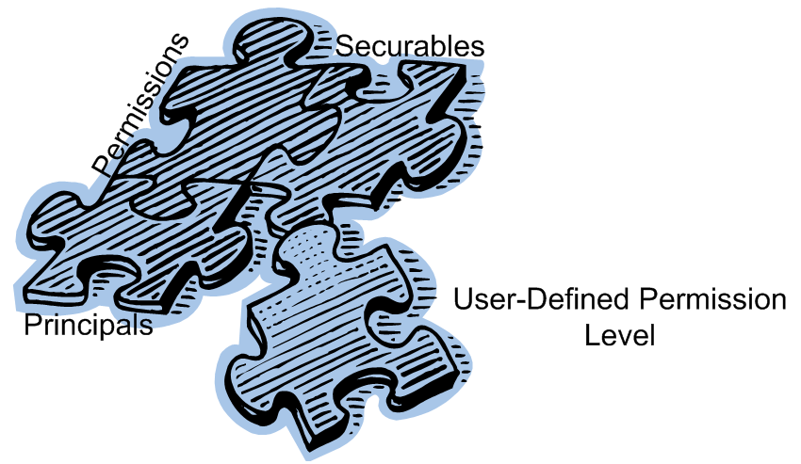
Customizable
Notes:
As if the ability to disable inheritance and grant permissions explicitly at any juncture of the site collection logical hierarchy weren’t enough, SharePoint also allows site administrators and site collection administrators to customize the SharePoint groups and permission level security objects that ship out of the box, even create their own.
Such extensibility increases the possible combinations of users and permissions that can be defined in SharePoint as well as the potential combinations of permissions (in the billions). In this manner administrators can be very selective in their permission assignments. For example, if the out of the box Permission Level called Contribute does not include just the right mix of individual permissions for your enterprise, you can copy the Contribute permission level to create a new permission level object, then give the new object a custom name and slightly alter the mix of permissions that it includes. You may then grant your new custom permission level object to the appropriate users.
NOTE: Though the SharePoint interface offers the ability to alter the individual permission mix of any of the system supplied permission level objects that ship out of the box (except Full Control and Limited Access), Microsoft Best Practices actually discourage altering these objects. Because Microsoft created these objects as part of the SharePoint application’s code, they cannot guarantee that future critical updates or service packs will not address these objects and potentially overwrite any customizations you make to them. Therefore, if you need to change the permission make up of a permission level it is preferable to copy that permission level to create a new object rather than alter the original.

Slide 9
DEMO
SharePoint Security
Notes:
In this demonstration, your instructor will illustrate viewing the components of the SharePoint security architecture including:
Principals
Permissions
Securables

Slide 10
Agenda
SharePoint Security Architecture
Default SharePoint Groups and Permission Levels
Designing and Implementing Custom Security
Restricting SharePoint Designer 2010 Use

Slide 11
Default SharePoint Groups
Depend on the site template and Features
Standard groups created on all sites:
Owners = Full Control
Members = Contribute
Visitors = Read
Supplemental groups created on specific sites:
Hierarchy Managers
Designers
Approvers
Notes:
SharePoint automatically creates certain groups for any new site generated with unique permission structure as a means of starting the site off with group-oriented permission administration. By default, SharePoint will always generate the following groups for all site templates:
Owner: Full Control permission level granted ; includes the creator of the site as the only member by default
Members: Contribute permission level granted ; includes the creator of the site as the only member by default
Visitors: Read permission level granted ; no default members
However, depending on the site template used to create the site and the Features that have been activated at the farm level, web application level and potentially the site collection level (for child sites being created with unique permissions) SharePoint may create additional groups by default including, but not limited to:
Hierarchy Managers: Manage hierarchy permission level granted ; no default members
Designers: Design permission level granted ; no default members
Approvers: Approve permission level granted ; no default members

Slide 12
Default Permission Levels
Depend on Features
Standard permission levels created:
Full Control = all 32 list, site and personal permissions
Contribute = read and manipulate list and library items
Read = view pages, list items and download files
Limited Access = browse/open a site and enumerate lists (not open items)
Supplemental permission levels:
Manage Hierarchy = 11 list permissions, 14 site permissions and 3 personal permissions (full control without list approve, security group create or site stylization)
Design = all 12 list permissions, 10 site permissions and 3 personal permissions
Approve = 11 list permissions, 7 site permissions and 3 personal permissions
Restricted Read = 2 list permissions (view and open items), 2 site permissions (view pages and open site)
View Only = 4 list permissions, 5 site permissions
Notes:
SharePoint also automatically creates permission level objects on each new top level site of a site collection. These permission level objects are then inherited by all children sites (by default) along a separate inheritance stream than that used to inherit SharePoint group objects and their permission assignments. By default, SharePoint will always generate the following permission levels for a new site collection:
Full Control (cannot be altered): all individual permissions are included
Contribute: 9 list permissions to view, add, update and delete list items and documents, 7 site permissions to access site & invoke client applications for documents, 3 personal permissions to personalize pages and views
Read: 5 list permissions to view list items and view/open documents, 5 site permissions to access site & invoke client applications for documents
Limited Access (cannot be altered): 1 list permission to enumerate the list, 4 site permissions to access site & invoke client applications
However, depending on the site template used to create the top level site of the site collection and the Features that have been activated at the farm and web application levels, SharePoint may create additional permission level objects by default including, but not limited to:
Manage Hierarchy: all list permissions except approve ; all site permissions except stylization and security group creation ; all personal permissions
Design: all list permissions ; all site permissions except viewing/changing permissions, creating/managing sites, or creating security groups ; all personal permissions
Approve: all list permissions except manage lists ; no site permissions beyond browsing/access ; all personal permissions
Restricted Read: Read minus version access or alerts on lists, and with no browse abilities beyond opening pages on sites
View Only: Read minus the ability to open any files

Slide 13
DEMO
Securing Sites
Notes:
In this demonstration, you will tour the default security objects created with new sites.

Slide 14
Agenda
SharePoint Security Architecture
Default SharePoint Groups and Permission Levels
Designing and Implementing Custom Security
Restricting SharePoint Designer 2010 Use

Slide 15
Common Criteria for Customizing Security
Distributed administration model
Regulatory compliance
Business rules and specific permission definitions
Business needs and granular assignments
Notes:
While Microsoft Best Practices encourage you to plan and implement security “from the top down” so that inheritance rarely, if ever, needs to be interrupted this just simply is not a practical method for many SharePoint enterprises. Various factors can introduce the need to customize the permissions being granted at a lower-level securable in the hierarchy.
The factors that influence security design are as widely varied as companies themselves, but one criteria that often seems to invite custom permissions is a distributed administration model. In this model, a different administrator or administrators are named for many hierarchical levels of the security architecture. Imagine both Sam and Becky being site administrators of the Sales site but only Becky should manage the Tasks list on the Sales site. Because the different permission needs come into play in this case on the lower level object in the hierarchy (list), custom permissions will be necessary on the Tasks list because if the list is left to its default setting to inherit its permissions from its parent (the Sales site) Sam will retain his ability to manage the list and this would violate the company’s administration model.
Also, regulatory or industry standards compliance may require a SharePoint enterprise to alter the manner in which it grants access to sensitive or confidential data. Business rules, in addition to regulations or standards, can also demand a more granular mix of permissions than those being inherited from above in the hierarchy. These can include preventing one malicious member in a SharePoint group from utilizing the group’s permissions or granting permissions to individuals rather than groups.
EXAMPLE: if a SharePoint Group called Sales Group already has the Read permission to a site, but one of the Sales personnel has been delegated as the author to that site and therefore needs additional privileges, the administrator of the site can grant Read to the Sales group and also grant Contribute to the selected individual’s person object. When a user, such as in the previous example, has been granted more than one permission assignment to the same securable, their effective permission is the cumulative total of all of their assignments. So for the delegated sales person in the example, they would have both Read and Contribute permission to the site while all of their compatriots in the Sales department have only Read (via their Sales group membership).

Slide 16
Designing Custom Security
Plan groups rather than individual assignments
Effective permission = cumulative total of all assignments (there is no “Deny” permission state like in NTFS file systems)
Some individual permissions are conglomerates that cannot be separated
Some individual permissions depend on others and must be invoked together
There is no native mechanism that will assign a specific permission structure to a newly added item (must use a workflow and/or approval)
Notes:
When designing a custom security model, plan to use SharePoint groups whenever possible to simplify administration. Even if there are only a few users who need the same level of access to the same resources, go ahead and define a group for them or choose an existing group if appropriate. A group that only has a few members today could grow to many members quickly if accessing a popular securable. Try to avoid repetitive administration of permissions for individual users. Also, when assigning permissions to either a group or person only permission levels appear in the browser interface to be assigned (it is not possible to grant a Principal the 32 individual permissions directly).
It is possible to grant a user permissions to the same securable more than once in SharePoint, such as when a user is a member of multiple groups, each of which has permissions to the securable. Or in the case where a user is granted permissions to a securable directly but is also a member of one or more groups that have access to the securable as well. If this occurs, the user will receive the cumulative total of all assigned permissions as their effective permission.
A common misconception in SharePoint is the idea that a permission can be “denied” instead of granted. In the Windows OS family, the NTFS file system could deny specific groups or users a particular permission, thereby banning that user from performing any operations against the folder that required the permission in question. All you had to do when assigning the permission was to use the Deny state instead of the Allow state. But in SharePoint there are only two states of a permission: allow (checked) or neutral (unchecked). The neutral state does not guarantee that a user will be prevented from performing operations requiring that particular permission, it simply does not grant them the authority to perform the operation (at this level). However, users may still acquire the necessary authority through another permission assignment (perhaps through membership in another group).
Some of the individual SharePoint permissions are combinations of granular abilities and cannot be separated. Take for example the Manage lists permission, which gives a Principal the authority to create and delete lists, add or remove columns in a list, and add or remove public views of a list. You cannot separate the duties of creating columns from the duty of creating/deleting entire lists!
Also, some of the individual SharePoint permissions depend on other permissions being assigned as well. This is called a dependency and SharePoint will automatically select any required permissions for your new assignment: Add items requires View items (SP will check View items when you, the human, check add items). BUT WORSE THAN THAT if you try to uncheck View items then the Add items will uncheck as well!!! So you cannot delegate a temp chick to input a bunch of rows but prevent her from A) going back and viewing her own work OR WORSE YET B) viewing items added by other people!

Slide 17
Implementing Custom Security
Document custom security plan
Create any custom permission levels first
Create any custom SharePoint group objects
Disable inheritance on only the lower level object demanding custom security
Add any additional permissions assignments first before removing any that were copied onto the object as a result of disabling inheritance that are no longer needed.
Notes:
Keep good notes any time you alter the inherited permission set as this may be your only hint as to why users experience trouble in the future. An important note you should add to your documentation is the fact that security inheritance is all or nothing. When you disable inheritance, the assignments that used to be inherited from the parent, will become listed as explicitly assigned permissions on the lower level object. If you decide to re-enable inheritance the object will lose all custom permissions and go back to only honoring the parent’s permission definitions. When documenting your plan, be sure to order object creation/modification in the following specific order:
Create Permission Levels
Create SharePoint Groups
Disable inheritance
Add new permission assignments
Remove old permission assignments
New groups must be granted a particular permission level during their creation, so it’s important to have the permission level objects created already. And adding new assignments before removing old assignments can prevent erroneously saving permission changes without naming a user who has the authority to modify permissions, thereby locking everyone out of the resource for administration purposes.

Slide 18
DEMO
Customizing Security Settings and Objects
Notes:
In this demonstration, your instructor will illustrate:
How to create custom SharePoint group objects.
How to create custom Permission Levels.
How to disable inheritance and implement custom security.

Slide 19
Agenda
SharePoint Security Architecture
Default SharePoint Groups and Permission Levels
Designing and Implementing Custom Security
Restricting SharePoint Designer 2010 Use

Slide 20
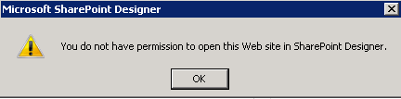
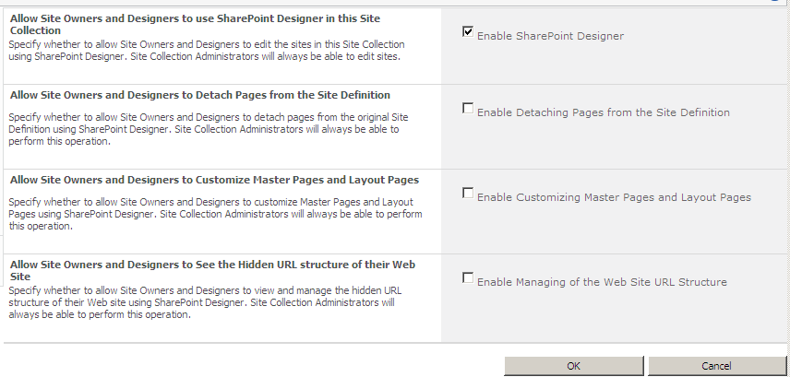
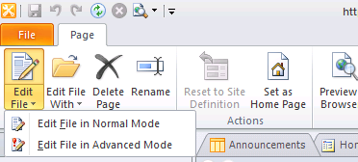
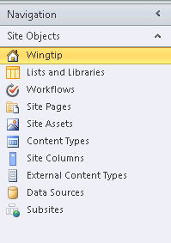
Restricting SharePoint Designer
Revoke permissions as needed from Site Owners and Designers
Notes:
SharePoint Designer is a powerful application. If not used properly, it can have adverse affects on the site.
Site collection administrators can decide to turn off certain features of SPD for Site Owners and Designers as shown in the image on the slide. All objects in SPD are context sensitive. Thus, if certain permissions are revoked, the appropriate objects will ‘turn off’ and become unavailable from the SPD interface (ex: Master Pages, All Files, Advanced editing mode etc).
Further, SharePoint farm administrators can limit SPD’s use within a Web application from Central Administration. These settings trump any site collection administrator’s selections (if blocks are used).

Slide 21
Summary
SharePoint Security Architecture
Default SharePoint Groups and Permission Levels
Designing and Implementing Custom Security
Restricting SharePoint Designer 2010 Use

